Slide 1
Hungarian Algorithm

Slide 2
What is the Hungarian Algorithm?
The Hungarian Algorithm is a combinatorial optimization algorithm that solves the assignment problem. It was developed and published in 1955 by Harold Kuhn, who gave the name "Hungarian method" because the algorithm was largely based on the earlier works of two Hungarian mathematicians: Dénes Kőnig and Jenő Egerváry. Since then the algorithm has been known also as the Kuhn–Munkres algorithm or Munkres assignment algorithm.

Slide 3
What is the assignment problem?
The problem instance has a number of workers and a number of tasks. Worker are assigned to perform tasks, incurring some cost that may vary depending on the worker-task assignment. It is required to perform as many tasks as possible by assigning at most one worker to each task and at most one task to each worker, in such a way that we get the maximum efficiency for each worker-task assignment.

Slide 4
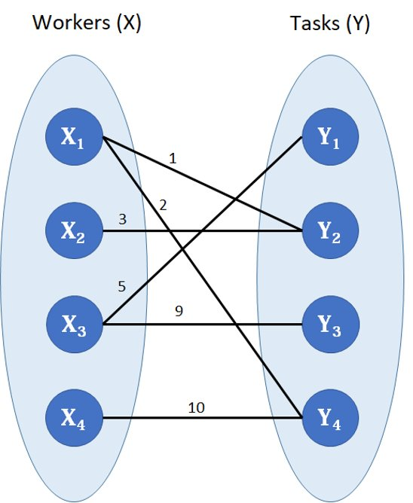
Visual representation
In many such problems, such as the ones previously mentioned, exhaustive search (Naïve Approach) is not tractable, and so specialized algorithms that quickly rule out large parts of the search space or approximation algorithms must be resorted to instead

Slide 5
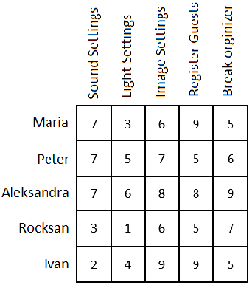
Example of a problem
Let an important scientific conference be planned. To conduct it, you need to set up sound, light, images, register guests and prepare for breaks between performances. There are 5 organizers for this task. Each of them has certain ratings for the performance of a particular job (suppose that these ratings are set as the arithmetic average of the reviews of their employees). It is necessary to distribute the organizers so that their total score is maximum.

Slide 6
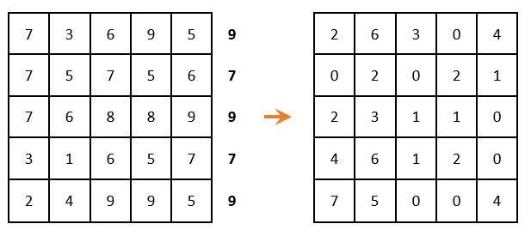
Hungarian Algorithm step by step
Step 1:
In each row of the matrix, it is necessary to find the maximum element, subtract it from each element of the corresponding row and multiply the entire matrix by -1. There must be only one selected zero per row and per column. (i.e., when zero is chosen, then the remaining zeros in this row or in this column are no longer taken into account).

Slide 7
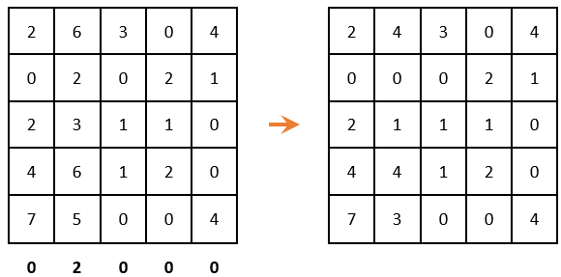
Hungarian Algorithm step by step
Step 2:
Matrix reduction by rows (we look for the minimum element in each row and subtract it from each element, respectively)
Because all minimal elements are zero, then the matrix has not changed. We carry out the reduction by columns:

Slide 8
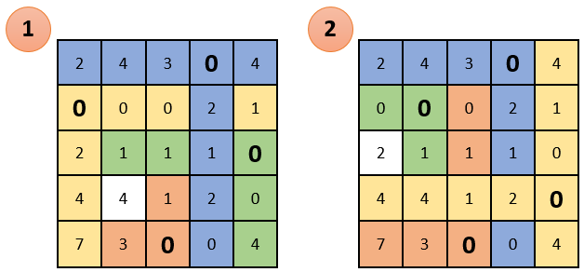
Hungarian Algorithm step by step
Step 3:
Again, we look to ensure that in each column and in each row, there is only one selected zero.In this case there are two options for choosing zeros, but none of them gives the desired result

Slide 9
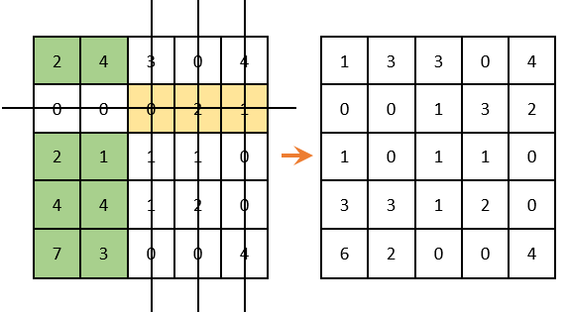
Hungarian Algorithm step by step
Step 4:
cross out rows and columns that contain zero elements (it is important that the number of cross outs should be minimal). Among the remaining elements, look for the minimum, subtract it from the remaining elements (which are not crossed out) and add to the elements that are located at the intersection of the crossed-out rows and columns.

Slide 10
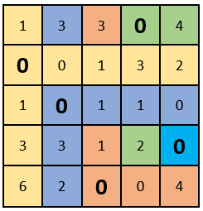
Hungarian Algorithm step by step
Step 5:
there is only one selected zero in each column and row. The solution is complete. After that we substitute the locations of the selected zeros in the initial table. We get the optimum, or the optimal plan, in which the organizers are distributed among the works and the sum of the marks is maximum:

Slide 11
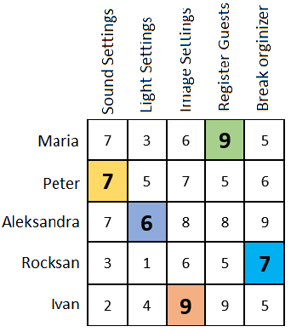
Hungarian Algorithm step by step
Step 6:
Substitution in the initial table, to display the optimal plan, in which the organizers are distributed among the works.
If the solution is still impossible then we repeat the algorithm from the place where the row reduction was carried out

